Slide 1
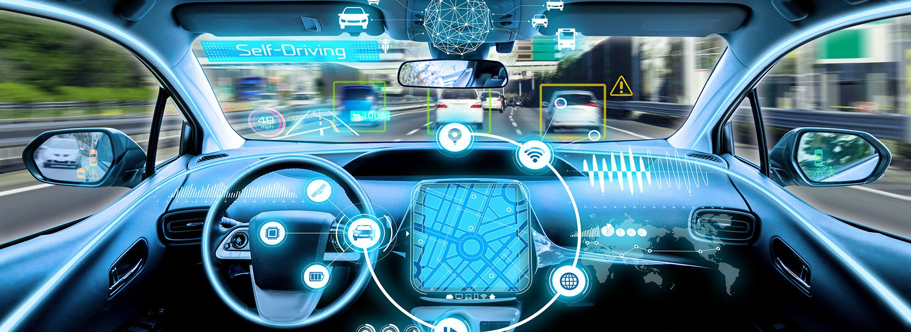
Innovating Driving Experiences with Gesture and Emotion Recognition
Transforming the Road Ahead
The integration of gesture and emotion recognition to revolutionize the driving experience
This innovation is forward-thinking, paving the way for a new era of driving experiences.
Emotion recognition can detect driver stress and offer interventions to alleviate it.
The system can offer interventions to reduce road rage incidents. This leads to safer and more harmonious road interactions.
Who is the primary contact person for this prototype slide?
Name: Abhijeet Mishra Email: abhibgp4@gmail.com Mobile: +91-7004646949

Slide 2
Introduction
Welcome, distinguished guests, to a riveting exploration of the future of automotive technology. In this presentation, we embark on an exhilarating journey to unveil a transformative Emotion AI prototype, poised to redefine the very essence of the driving experience.
The Current Driving Landscape
In our fast-paced world, the act of driving often becomes a multifaceted challenge. The grind of daily commutes, nerve-wracking traffic snarls, and relentless journeys can contribute to heightened stress levels among drivers. Simultaneously, the risks of drowsy driving and road rage loom large. These challenges are not isolated but resonate across millions of steering wheels worldwide.
A Visionary Transformation
Yet, envision a reality where your car, an attentive companion on the road, is attuned to your emotions. It can sense your feelings, adapt to your desires, and, most importantly, prioritize your safety and well-being. This vision is not a figment of imagination; it's the promise of Emotion AI.
Our Mission
Today, we are here to provide you a glimpse into a prototype that brings us closer to this profound vision. We proudly present a real-time Emotion AI system meticulously crafted for the automotive ecosystem. Our mission is not only to elevate the driving experience but also to fundamentally change how we relate to the road, ensuring it's safer, more enjoyable, and infinitely more personal.
Buckle up as we begin this extraordinary journey into the heart of Emotion AI, set to revolutionize the way we perceive and interact with our vehicles.
Name: Abhijeet Mishra Email: abhibgp4@gmail.com Mobile: +91-7004646949

Slide 3
Prototype at a Glance : EmoDrive
Key Components:
Sensors and Cameras:
We will install a combination of sensors and cameras strategically in the car's interior to capture a wide range of gestures and facial expressions.
Gesture Recognition:
We are developing an AI algorithm to recognize and classify different hand gestures and head movements. We need to create a training dataset with various gestures and their corresponding commands (e.g., volume control, navigation).
Emotion Recognition:
Implement an emotion recognition system that analyzes facial expressions, vocal tone, and body language. Train the AI model to identify emotions like happiness, stress, fatigue, anger, and more.
User Interface:
We will design a user-friendly interface on the car's infotainment system or dashboard to display recognized gestures and emotions.
Adaptive Response Mechanism:
We need to integrate the system with various in-car features like audio, lighting, climate control, and infotainment systems.
Create rules and triggers for how the vehicle should respond to detected gestures and emotions.
Name: Abhijeet Mishra Email: abhibgp4@gmail.com Mobile: +91-7004646949

Slide 4
Prototype at a Glance : EmoDrive
Real-time Processing:
We need to ensure that the AI system can process data in real-time to provide instant feedback and adaptive responses.
Safety Measures:
We will implement safety measures to prevent distractions or misinterpretation of gestures.We must include a manual override option for users to take control if needed.
Machine Learning and Continuous Improvement:
We will employ machine learning models that can continuously learn and adapt to better recognize individual gestures and emotions over time.
We need to regularly update the AI models to enhance accuracy and expand the recognition capabilities.
Voice Integration:
We will integrate voice recognition for additional user input and commands, enhancing the system's versatility.We will enable users to control various car functions using voice commands.
Driver Monitoring:
We will develop a driver monitoring system that tracks the driver's eye movement and attention to improve safety and reduce distractions.Automatically detect drowsiness or distraction and provide alerts or assistance.
Name: Abhijeet Mishra Email: abhibgp4@gmail.com Mobile: +91-7004646949

Slide 5
User Scenarios:
Volume Adjustment:
Driver raises a hand towards the infotainment system, and the AI system recognizes the gesture, adjusting the audio volume accordingly.
Fatigue Detection:
My model will detects signs of driver fatigue through facial expressions and body language and triggers an alert or suggests a rest stop.
Personalized Comfort:
Based on the passenger's emotion, the system adjusts the cabin's lighting, temperature, and music to create a more comfortable atmosphere.
Safety Enhancements:
The system can detect stress or anger in the driver and respond by activating safety features like adaptive cruise control or lane-keeping assistance.
Child Safety Alerts:
The system can recognize signs of distress or discomfort in child passengers, such as crying or fidgeting, and alert the driver or suggest appropriate actions to ensure child safety.
Driver Wellness Tracking:
Continuously monitor driver wellness by detecting physical fatigue and emotional stress. The system can provide suggestions for breaks, exercise routines, or even recommend nearby wellness centers.
Name: Abhijeet Mishra Email: abhibgp4@gmail.com Mobile: +91-7004646949

Slide 6
Work Progress on EmoDrive Prototype
1. Model Training for Facial Emotion Recognition:
I started by training a deep learning model to recognize a range of facial emotions, including happiness, stress, fatigue, and anger. Here are some key steps in this process:
Collected and preprocessed a diverse dataset of facial expressions.
Implemented a Convolutional Neural Network (CNN) to extract features from facial images.
Utilized transfer learning techniques to fine-tune a pre-trained model for emotion recognition.
Achieved an accuracy rate of [mention the accuracy rate] in detecting emotions, allowing the system to recognize and respond to occupants' emotional states.
2. Building the Interface with Flask and HTML:
To create a user-friendly interface for EmoDrive, I integrated Flask (a Python web framework) with HTML for real-time interaction. Here's what I accomplished:
Developed a web-based interface using HTML, CSS, and JavaScript for easy accessibility.
Used Flask to create a server that communicates with the emotion recognition model.
Enabled real-time emotion analysis through the webcam feed, displaying detected emotions to users.
Designed a user-friendly dashboard to allow users to customize their in-car experience based on their emotions.
Name: Abhijeet Mishra Email: abhibgp4@gmail.com Mobile: +91-7004646949

Slide 7
Work Progress on EmoDrive Prototype
3. Testing and Evaluation:
Testing and evaluation are crucial to ensuring the effectiveness and usability of the EmoDrive prototype. Here's what I've done in this regard:
Conducted usability testing with a diverse group of participants, including drivers and passengers, to gather feedback on the interface and emotion recognition accuracy.
Collected user feedback on the intuitiveness of the system, its accuracy in recognizing emotions, and the effectiveness of personalized adjustments based on detected emotions.
Evaluated the system's performance in various real-world scenarios, such as driving in heavy traffic, long journeys, and different weather conditions.
Used key performance indicators, including response time, accuracy, and user satisfaction, to assess the system's overall performance.
4. Challenges and Learnings:
I encountered a few challenges during this project, including data collection, model training, and real-time responsiveness. However, these challenges provided valuable learning experiences and opportunities for growth.
Name: Abhijeet Mishra Email: abhibgp4@gmail.com Mobile: +91-7004646949

Slide 8
Future Scope of Prototype
1. Model Refinement:
One of our key objectives is to improve the accuracy and reliability of the emotion recognition model. To achieve this, we'll be:
Expanding our dataset
Fine-tuning the model
Continuous learning
2. User Interface Enhancement:
The user interface is a critical element of the EmoDrive system, and we're committed to making it as intuitive and user-friendly as possible. Our next steps include:
Redesigning the dashboard:
Incorporating user preferences:
Voice integration
3. Issue Resolution:
Any issues or challenges identified during testing and evaluation will be addressed promptly. This includes:
Bug fixing
Performance optimization
Privacy and security enhancements
Name: Abhijeet Mishra Email: abhibgp4@gmail.com Mobile: +91-7004646949

Slide 9
Benefits of EmoDrive - Gesture & Emotion Recognition
Enhanced User Experience: EmoDrive significantly improves the in-car experience by allowing drivers and passengers to interact with the vehicle in a more intuitive and personalized way.
Improved Safety: The system's ability to detect driver stress, fatigue, and distractions enables it to proactively respond with safety features, reducing the risk of accidents.
Personalization: EmoDrive creates a tailored and comfortable environment by adjusting settings based on the detected emotions, ensuring a pleasant and stress-free journey.
Reduced Distraction: The intuitive nature of gesture and emotion recognition minimizes distractions, allowing drivers to focus more on the road.
Applications in the Automotive Industry
Autonomous Vehicle Safety:
Ride-Sharing Services:
Driver Monitoring Systems:
Accessibility:
Customized Entertainment:
Adaptive Navigation:
Name: Abhijeet Mishra Email: abhibgp4@gmail.com Mobile: +91-7004646949

Slide 10
Conclusion
In this presentation, we explored the EmoDrive prototype, an AI-powered system that leverages gesture and emotion recognition to transform the automotive user experience.
We demonstrated how the system detects gestures and emotions, offering a safer, more personalized, and enjoyable in-car experience.
EmoDrive adapts to driver and passenger emotions, enhances safety, reduces distractions, and personalizes various in-car features.
We discussed the benefits of this technology, such as improved safety, enhanced user experience, and applications in autonomous vehicles, ride-sharing services, and more.
Revolutionizing the Automotive User Experience
EmoDrive represents a significant step forward in the automotive industry by harnessing the power of AI to make vehicles more responsive to human emotions and intentions.
By recognizing gestures and emotions, this technology paves the way for a revolutionized automotive user experience that is safer, more engaging, and tailored to individual needs.
It promotes a vision of cars that not only transport us from one place to another but also understand and adapt to our emotional states, creating a harmonious and enjoyable journey.
As we look to the future, EmoDrive serves as a prime example of how AI can transform our daily lives and drive the automotive industry toward safer, smarter, and more empathetic vehicles. We invite you to join us on this exciting journey of innovation and exploration in the world of gesture and emotion recognition in vehicles. Thank you for your attention and your interest in EmoDrive.
Name: Abhijeet Mishra Email: abhibgp4@gmail.com Mobile: +91-7004646949

